Slide 1
Week 1 Introduction to Console Applications with Eclipse

Slide 2
Introduction
Lewis Evans
Post-Graduate Teaching Assistant (PGTA)
Office hours (E113)
Mondays 1-3pm
Thursdays 11-12pm
Fridays 4-5pm

Slide 3


Outline
Outline of Programming 2
Console Applications
Gathering user input

Slide 4
Outline of Programming 2
Unit Outline
Console Applications
Gathering User Input

Slide 5
Unit Outline
Week 1
Week 2
Week 3
Week 4
Week 5
Week 6
Intro to Eclipse and Console Applications
Gathering User Input
Arrays & ArrayLists
Object-Oriented Analysis & Design
Inheritance
File Handling
Exceptions
Graphical User Interfaces (GUIs)
Guest Lecture Assistant Vice President / Test Lead
Testing
Unit Outline
Console Applications
Gathering User Input

Slide 6
Unit Outline
Week 1
Week 2
Week 3
Week 4
Week 5
Week 6
3-Week Xmas break
Week 7
Unit Outline
Console Applications
Gathering User Input

Slide 7
Assessment
The assessment for this unit is a game developed in Processing, which is worth 100% of the unit mark
If the assessment is in Processing, why are we bothering with another IDE?
Naturally, your other programming-related units, either later in this year or in years 2 & 3, will not involve making games in Processing
Your other units will use more advanced IDEs
Unit Outline
Console Applications
Gathering User Input

Slide 8




Support
Support Sessions
Lecturer Office Hours
Discord
Teams / Email
Dr Susan Lomax is available for both 1-to-1 support sessions and group sessions
Booked via Moodle and undertaken on MS Teams
Every tutor on this unit has office hours – time they have set aside for students to meet with them
Can be found on Moodle
This unit will use the Discord server from Programming 1 (link available on Moodle)
Unit-wide channels and lab-specific channels
You can also email your lab tutor or send them a message on Teams
Unit Outline
Console Applications
Gathering User Input

Slide 9
Weekly Breakdown
A 15-credit unit assumes 150 hours of study
Divided by 7 (6 teaching weeks + 1 assessment) = 21.4 hours a week
Subtract from that the lecture (1 hour) and lab (3 hours) = 17.4 hours of independent study every week
Unit Outline
Console Applications
Gathering User Input

Slide 10
Console Applications
Unit Outline
Console Applications
Gathering User Input

Slide 11

Console Applications
In Programming 1, we looked at the fundamentals of Programming from a visual perspective to create graphical applications, by drawing shapes and developing simple games
The Processing Integrated Development Environment (IDE) allowed us to use the Java syntax (rules and style of Java) to develop such applications
In Programming 2, we will focus more on console applications
Console applications do not involve a graphical interface, meaning they are fast to develop and suitable for many common tasks
This unit will use Eclipse – a popular IDE for developing Java applications
Unit Outline
Console Applications
Gathering User Input

Slide 12

Eclipse
Eclipse is used in industry for developing Java and Android applications
Good debugging facilities
Easy to manage larger Java projects
Very powerful
Quite complex (lots more buttons than Processing)
Easy introduction for our purposes
Unit Outline
Console Applications
Gathering User Input

Slide 13
Java Applications
Java can be used to write all kinds of applications
E.g. web server, mobile apps, console apps
All Java code is object-oriented (OO)
Console applications are not event-driven
Console applications need to know where to start – which class?
In Processing – setup, then draw
In Console applications – main method
Unit Outline
Console Applications
Gathering User Input

Slide 14

Using Eclipse
Unit Outline
Console Applications
Gathering User Input

Slide 15
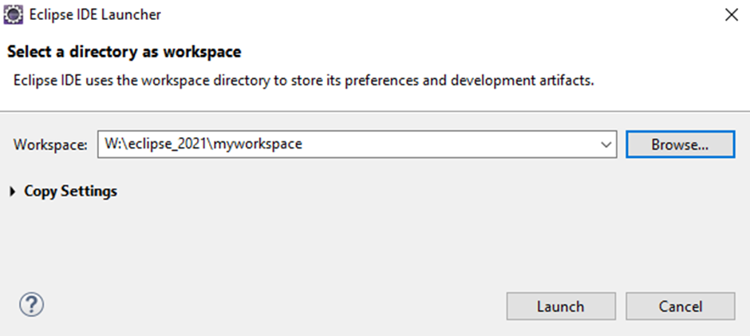
Using Eclipse
When launching Eclipse, you may be prompted to select a directory to use as your workspace
Your workspace will contain Projects – sub-folders that contain source code specific to a project
Use the W: drive – dedicated drive for your workspace
Do NOT use OneDrive – syncing issues
Unit Outline
Console Applications
Gathering User Input

Slide 16
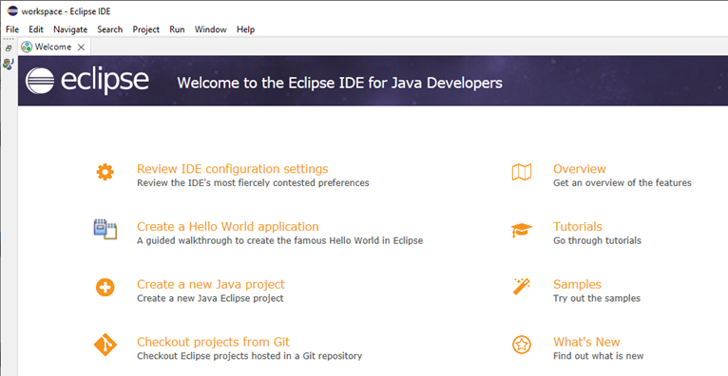
Using Eclipse
Welcome screen shown the first time Eclipse launches, click X to close
Unit Outline
Console Applications
Gathering User Input

Slide 17
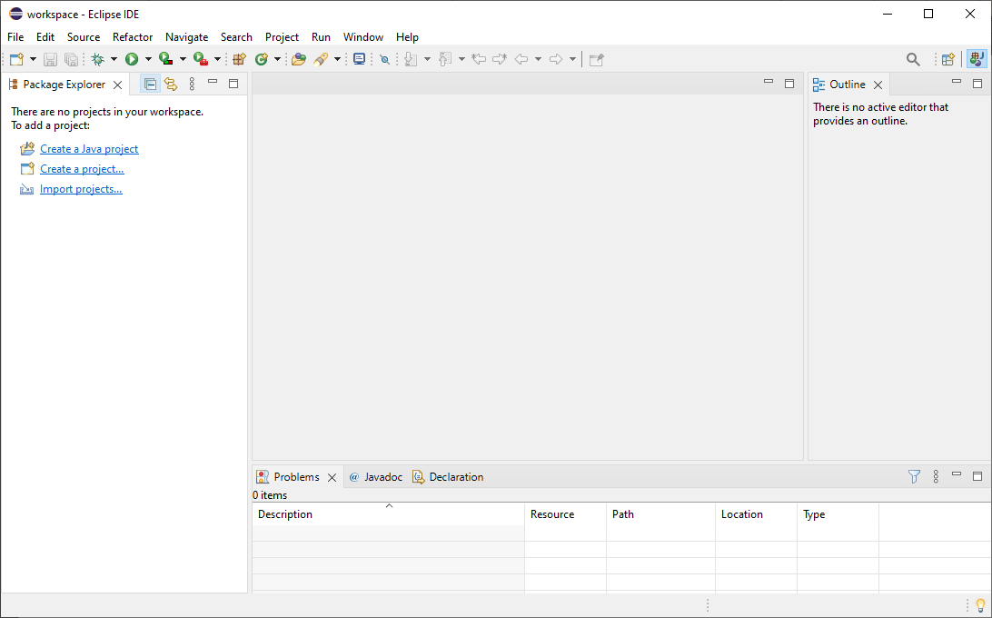
Package explorer – contains a view of all Projects in the workspace
Unit Outline
Console Applications
Gathering User Input

Slide 18
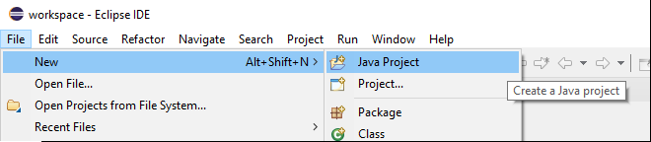
Using Eclipse
First thing we want to do is create a Project. A Project is a folder that can contain source code and other files specific to a project.
File -> New -> Java Project
Unit Outline
Console Applications
Gathering User Input

Slide 19
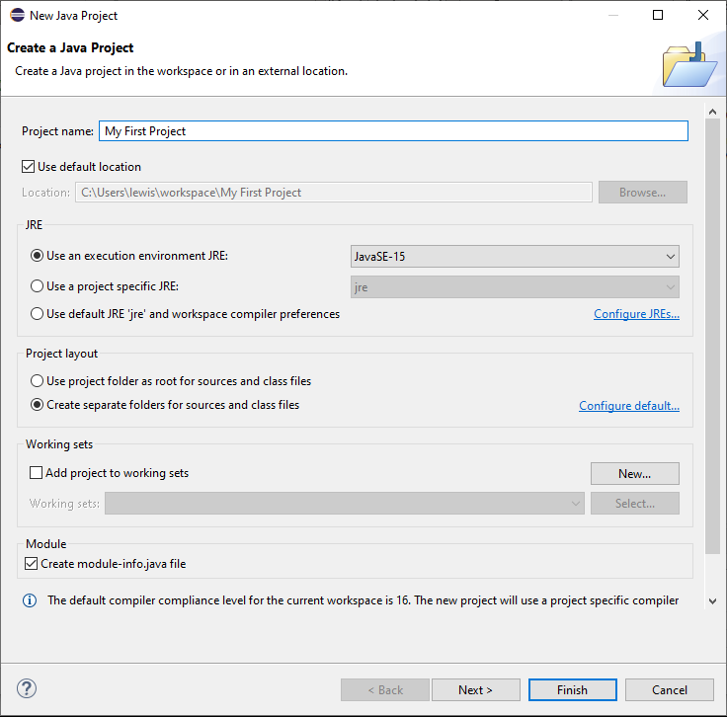
Project Name – can contain spaces
Java Version to use for this project (we will be using Java 15 in the labs). This is automatically selected.
Module – untick Create module-info.java file
That’s it! - Finish
Unit Outline
Console Applications
Gathering User Input

Slide 20
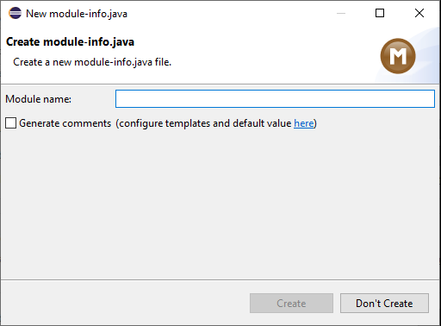
Using Eclipse
If you forget to untick “Create module-info.java file” on the Project creation screen, you will be asked to create a module-info.java file. Just click Don’t Create
Unit Outline
Console Applications
Gathering User Input

Slide 21
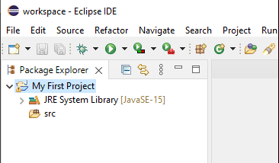
Using Eclipse
Your project will then appear in the package explorer
JRE System Library – Java Runtime Environment. This is the collection of standard built-in classes that come with Java that we can use in our programs
src – source folder (will contain all the source code we will write) – classes
Unit Outline
Console Applications
Gathering User Input

Slide 22
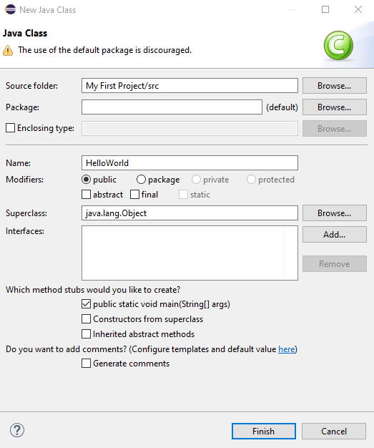
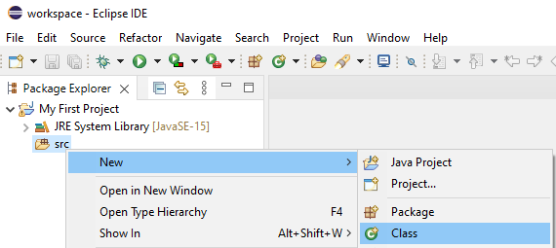
Using Eclipse
Class Name
Remember: Should begin with capital letter and cannot contain spaces
Once we have a Project, we can create our first class!
Tick public static void main
- This will insert the main method into the class, allowing it to run (similar to setup in Processing)
Unit Outline
Console Applications
Gathering User Input

Slide 23
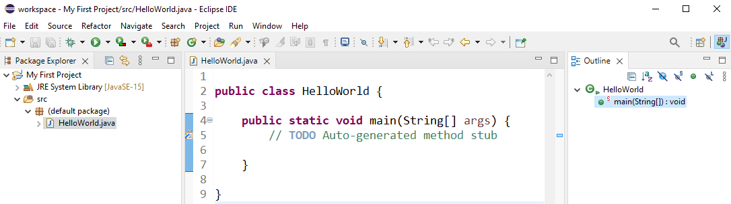
Using Eclipse
After all that hard work, we now have a Class that contains a main method
public static void main (String[] args)
static – does not require us to create an object of this class in order to run (i.e. we don’t need to create a HelloWorld object to call the method)
void – method will not return anything
Unit Outline
Console Applications
Gathering User Input

Slide 24
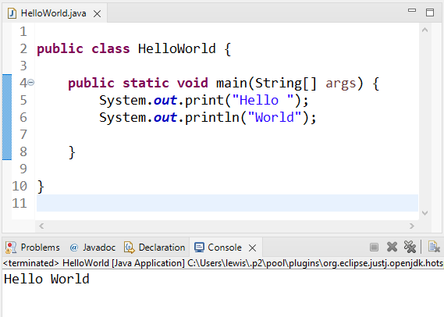
Using Eclipse
System.out.print()
Prints a string message to the console
System.out.println()
Prints a string message to the console and moves to the next line (adds a carriage return)
An empty println statement will simply print out a blank line
Console Output
This window will appear when your program produces output
Unit Outline
Console Applications
Gathering User Input

Slide 25
Gathering User Input
Unit Outline
Console Applications
Gathering User Input

Slide 26
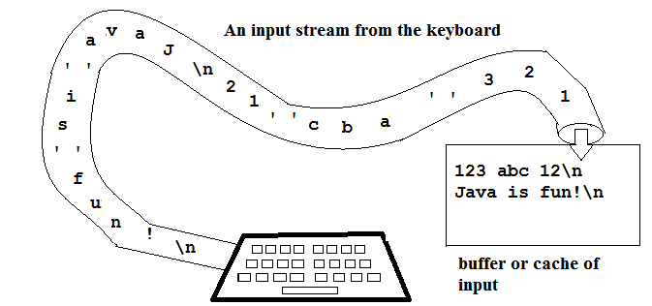
Gathering User Input
In Java Console applications, Input/Output (I/O) is handled by streams
A steam can come from (or go to) many data sources – default is the keyboard
All keyed input stored in a stream – we can then retrieve the input using various commands
A stream could also contain characters we don’t want – e.g. carriage returns, spaces
To gather input, we can use one of Java’s built-in classes – Scanner class
Unit Outline
Console Applications
Gathering User Input

Slide 27
The Scanner class
The Scanner class is part of the Java library, and allows us to read input (of many types), which can then be stored into variables
To use a class from the java library, we need to import it into our program by using an import statement
There are thousands of classes in the standard Java library, and these classes live in packages – groups of related classes
The Scanner class lives in a package called java.util (Java utilities)
Unit Outline
Console Applications
Gathering User Input

Slide 28
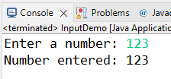
Scanner Demo
Import Statement
Tell the program that we want to use the built-in Scanner class from the java.util package
import java.util.Scanner;
public class ScannerDemo {
public static void main(String[] args) {
// create a Scanner object and assign to variable keyboard
Scanner keyboard = new Scanner(System.in);
System.out.print("Enter a number: ");
int number = keyboard.nextInt(); // read next int and store in variable
keyboard.close(); // close the stream - we're finished using it
System.out.println("Number entered: " + number);
}
}
Prompt User
Prompt user to enter a number
Create Scanner object
Create an object (instance) of the Scanner class, and “hook it up” to System.in (default keyboard)
Read Integer
Read integer from keyboard using nextInt() method (part of the Scanner class)
Print Result
Prints the value fetched and stored in number variable.
+ concatenates
Unit Outline
Console Applications
Gathering User Input

Slide 29
Scanner class Methods
The Scanner class has many methods to collect different types of inputs, to name a few:
nextLine() – reads in line of text as a String (e.g. “Hi there”)
nextFloat() – read in the next floating point number
nextBoolean() – reads in the next boolean
Unit Outline
Console Applications
Gathering User Input

Slide 30
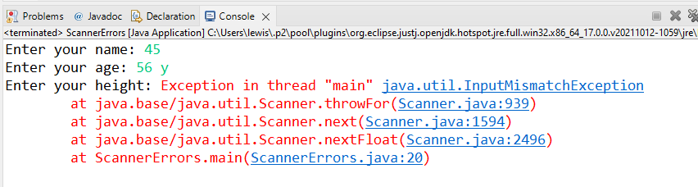
Scanner Errors
1st input expects a String, so reads 45 as “45”
2nd input expects an integer and grabs 56 from the stream
3rd input expects a floating point number, but error due to “ y” left on the input stream
Input validation techniques can be used to resolve this (Lab B of this week)
Unit Outline
Console Applications
Gathering User Input

Slide 31

Summary
Moving over to Eclipse from Processing
Console Output
print / println
String type – sequence of characters
Streams – input / output
Scanner class – collecting input
Can collect input from an input stream by using Scanner’s methods – e.g. nextLine(), nextInt()
Unit Outline
Console Applications
Gathering User Input

